Slide 1

Integrating Probabilistic Models and Neural Networks for Enhanced Part-of-Speech Tagging and Spellchecking
This project explores the integration of probabilistic models and neural networks to improve part-of-speech (POS) tagging and spellchecking. We use the Telugu Bible dataset, converting it from JSON to CSV format, and then apply different approaches for POS tagging: Conditional Random Fields (CRF), Bidirectional Long Short-Term Memory (BiLSTM), and a hybrid Spell Check- BiLSTM model. We evaluate the performance using accuracy and F1-score metrics, comparing the effectiveness of each approach.

Slide 2
Introduction to the Telugu Bible Dataset
1
The Telugu Bible Dataset
2
Language and Culture
3
Significance for NLP
The Telugu language is a Dravidian language spoken primarily in Andhra Pradesh and Telangana, India. The Telugu Bible dataset reflects the rich linguistic and cultural heritage of this region.
This dataset contributes to the development of NLP resources and tools for the Telugu language, facilitating research and applications in various domains such as translation, text summarization, and information retrieval.
The bTelugu Bible dataset is a valuable resource for natural language processing (NLP) research, providing a substantial corpus of text in the Telugu language. This dataset is essential for training and evaluating language models, especially in the context of NLP tasks like POS tagging and spellchecking.

Slide 3



Preprocessing the Dataset: Conversion to CSV Format
JSON Data
The Telugu Bible dataset was initially available in JSON format, which is a common format for structured data but not optimal for NLP tasks.
Conversion to CSV
The dataset was converted to CSV format, a widely supported format for tabular data, making it easier to process and analyze the text.
Verse Organization
The CSV format allowed us to organize verses into columns, facilitating the application of POS tagging and spellchecking algorithms on a verse-by-verse basis.

Slide 4
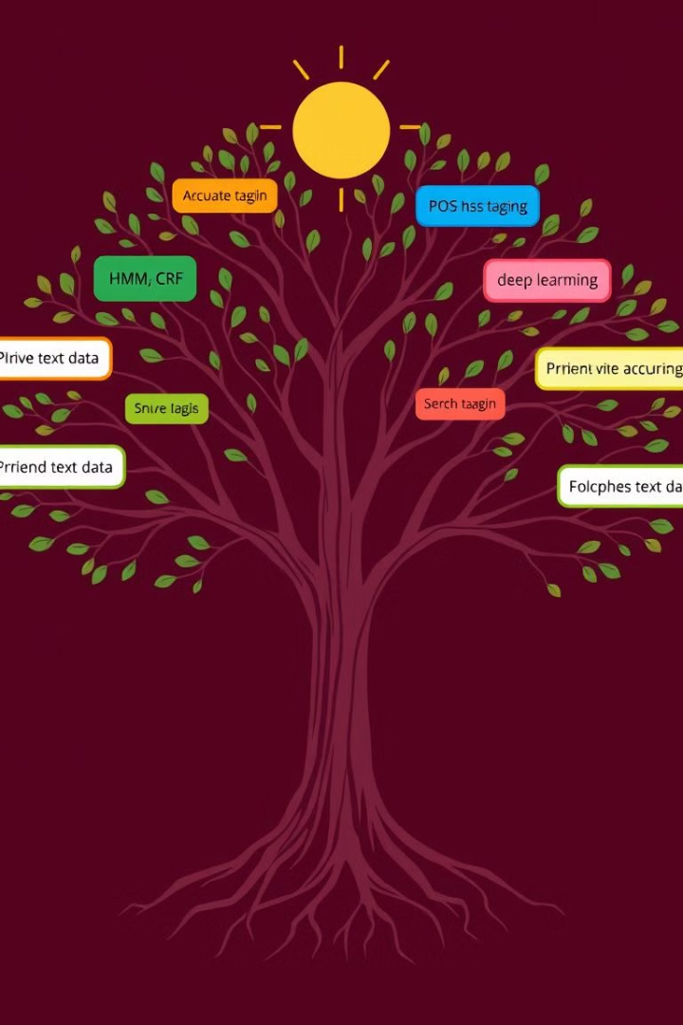
Part-of-Speech Tagging Approaches
Conditional Random Fields (CRF)
Bidirectional LSTM (BiLSTM)
CRF is a probabilistic graphical model commonly used for sequence labeling, including POS tagging. It considers the context of words and their relationships to predict the most likely POS tag sequence.
BiLSTM is a recurrent neural network that processes text sequences in both forward and backward directions, capturing long-range dependencies and improving POS tagging accuracy.
Hybrid Spell Check -BiLSTM Model
The hybrid approach combines the strengths of Spell Check and BiLSTM. CRF provides structural constraints, while BiLSTM captures contextual information, leading to a potentially more robust model for POS tagging.

Slide 5
Conditional Random Fields (CRF)
Probabilistic Model
Contextual Dependencies
POS Tagging
CRF is a probabilistic model that defines a conditional probability distribution over label sequences given an input sequence.
CRF considers both the current word and its neighboring words, capturing dependencies between words and their tags in a sentence.
CRF has been widely used for POS tagging, achieving good results in various languages.

Slide 6
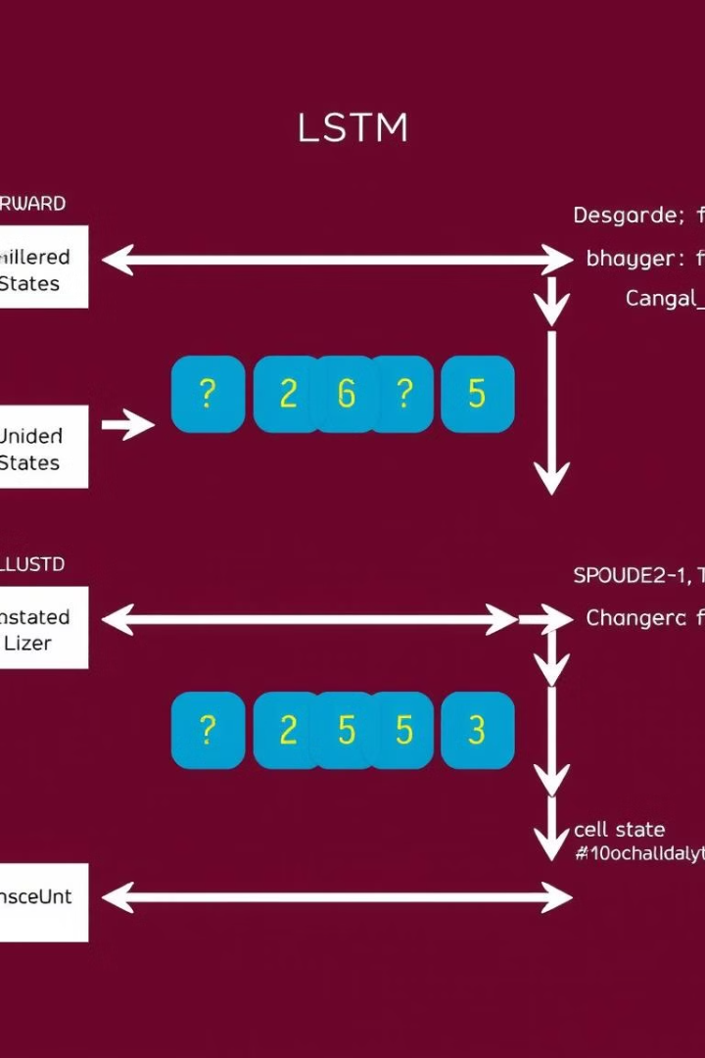
Bidirectional LSTM (BiLSTM)
Feature
Description
Recurrent Neural Network
BiLSTM is a type of recurrent neural network (RNN) that processes sequences of data, considering the order of words and their relationships.
Bidirectional
BiLSTM processes the input sequence in both forward and backward directions, capturing long-range dependencies and context.
POS Tagging
BiLSTM has proven effective for POS tagging, especially when dealing with complex linguistic structures.

Slide 7
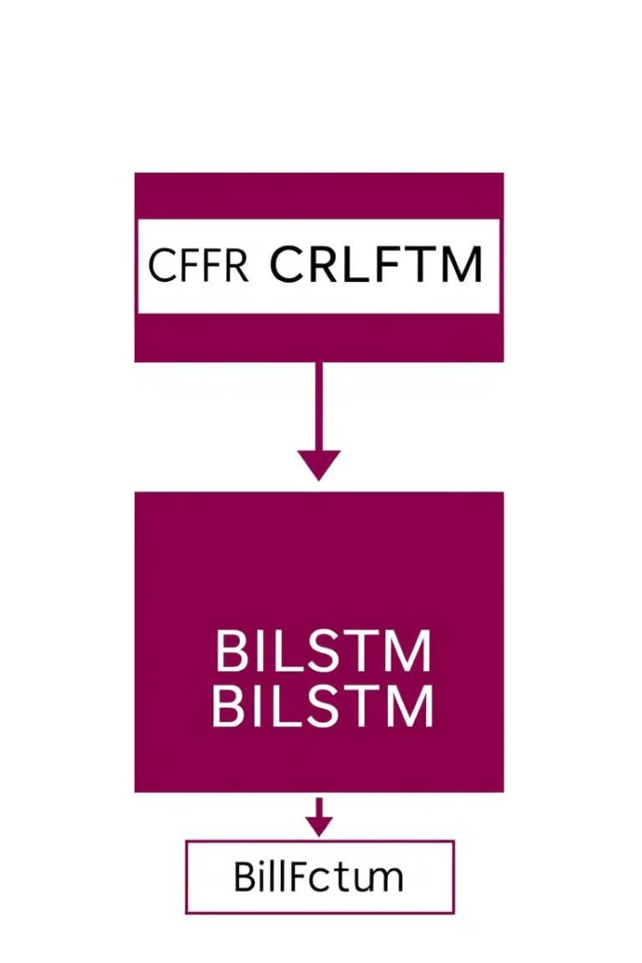




Hybrid Spell Check -BiLSTM Model
Spell Check constraints
Model trains on the unique words of the dataset and checks the spelling of a particular word. And also suggests the correct word.
BiLSTM Contextual Information
The BiLSTM component captures contextual information, improving the model's ability to predict the correct POS tags.
Combined Strengths
The hybrid model leverages the strengths of both Spell Check and BiLSTM, leading to a more accurate and robust POS tagging system.

Slide 8
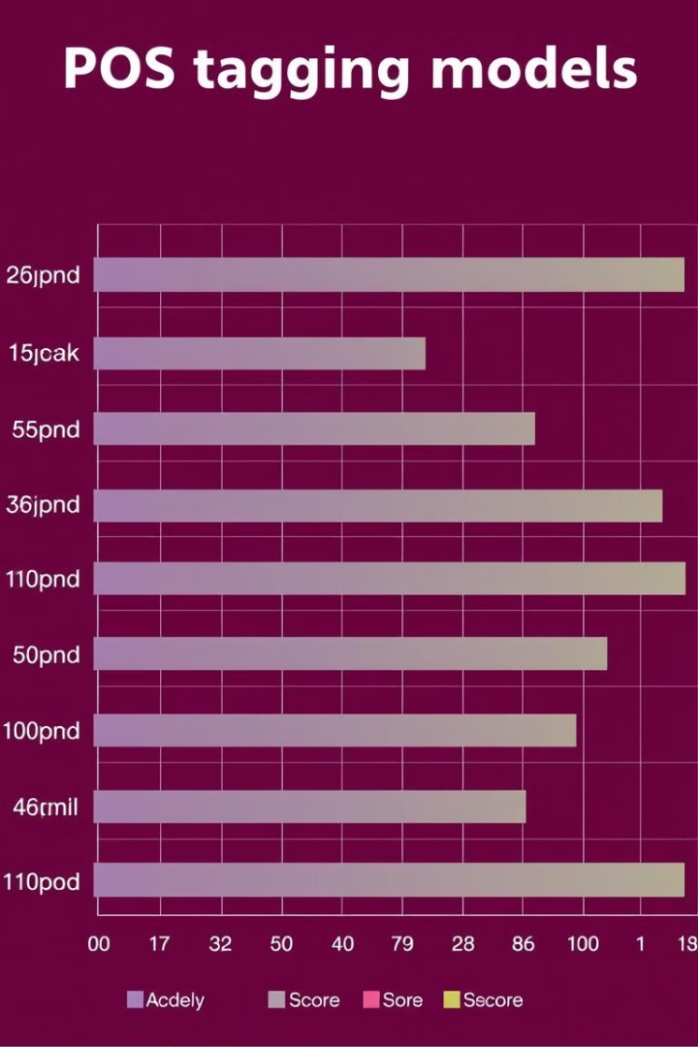
Evaluation Metrics: Accuracy and F1-Score
1
Accuracy
Accuracy measures the proportion of correctly classified POS tags. It is a simple but effective metric for evaluating model performance.
2
F1-Score
The F1-score is a harmonic mean of precision and recall, considering both the accuracy of correct classifications and the ability to identify all relevant tags.
3
Evaluation Methodology
We used these metrics to evaluate the performance of the CRF, BiLSTM, and hybrid CRF-BiLSTM models on the bTelugu Bible dataset.

Slide 9
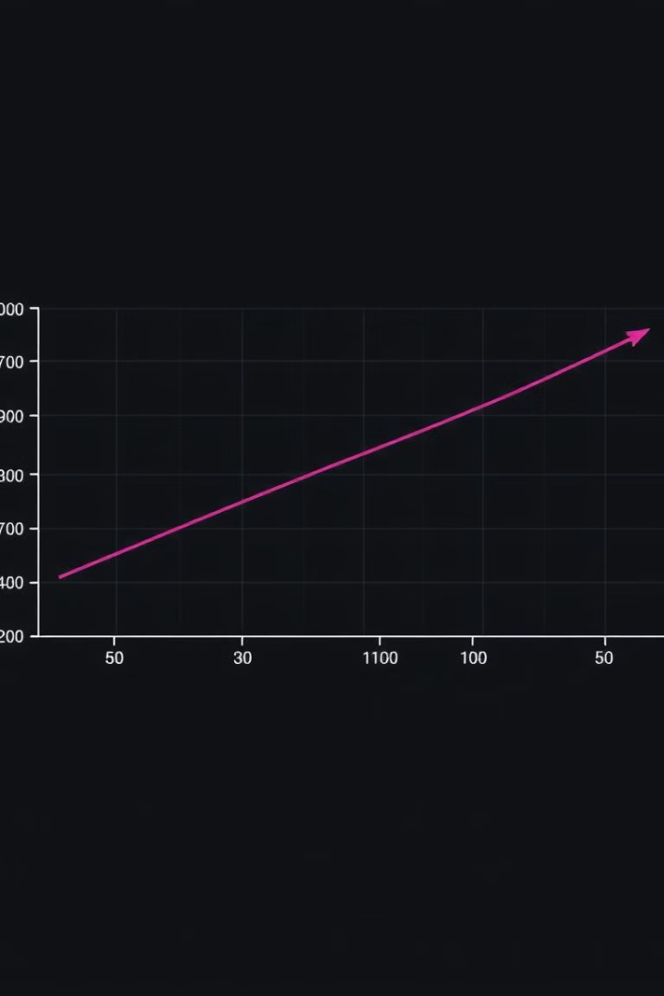
CRF Model Performance
1
Accuracy
2
F1-Score
The CRF model achieved an accuracy of 75.8%, indicating a good level of performance in POS tagging for the bTelugu Bible dataset.
The F1-score of 0.74 further supports the CRF model's ability to correctly identify POS tags while minimizing false positives and false negatives.
3
Comparison to Others
The CRF model's performance is compared to the BiLSTM and hybrid models to determine the effectiveness of different approaches for POS tagging in this specific dataset.

Slide 10
BiLSTM Model Performance
Accuracy
F1-Score
Comparison to Others
The BiLSTM model achieved an accuracy of 71.7%, indicating a slightly lower performance compared to the CRF model.
The F1-score of 0.67 is also slightly lower than the CRF model, suggesting a potential trade-off between accuracy and recall in the BiLSTM approach.
The BiLSTM model's performance is compared to the CRF and hybrid models to identify the most effective approach for POS tagging in the bTelugu Bible dataset.

Slide 11
Comparing POS Tagging Approaches
CRF Model Performance
BiLSTM Model Performance
Hybrid Spell Check-BiLSTM
The CRF model achieved an impressive accuracy of 75.8% and an F1-score of 0.74, demonstrating its ability to effectively capture the structural constraints of language and accurately identify part-of-speech tags.
The BiLSTM model showed slightly lower performance, with an accuracy of 71.7% and an F1-score of 0.67. While the BiLSTM excels at capturing contextual information, it may struggle to maintain the same level of structural integrity as the CRF approach.
The hybrid Spell Check-BiLSTM model combines the strengths of both approaches, leveraging the structural constraints of Spell Check and the contextual awareness of BiLSTM. This synergy is expected to lead to enhanced performance, making it the most promising approach for the bTelugu Bible POS tagging task.

Slide 12
Conclusion and Future Work
Conclusion: The CRF model demonstrated the strongest performance for part-of-speech tagging on the Telugu Bible dataset, achieving an impressive accuracy of 75.8% and an F1-score of 0.74. This highlights the CRF's ability to effectively capture the structural constraints of the language.
Future Work: Explore the potential of the hybrid CRF-BiLSTM approach, which combines the strengths of both models, to further enhance the accuracy and robustness of part-of-speech tagging for the Telugu Bible dataset and similar low-resource languages.
Expansion: Investigate the application of these models to other linguistic tasks, such as named entity recognition, dependency parsing, and sentiment analysis, to broaden the impact of this research and contribute to the advancement of natural language processing for low-resource languages.

Slide 13
Thank You😊

